Slide 1

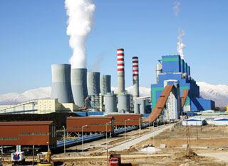
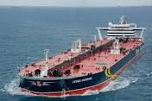
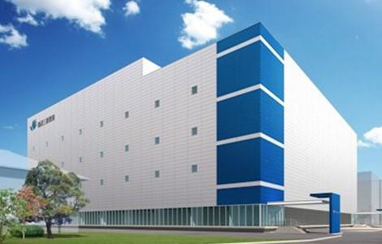
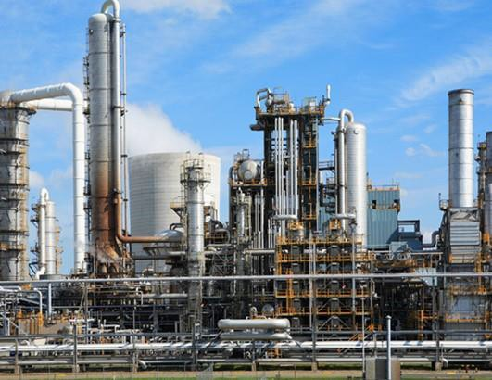
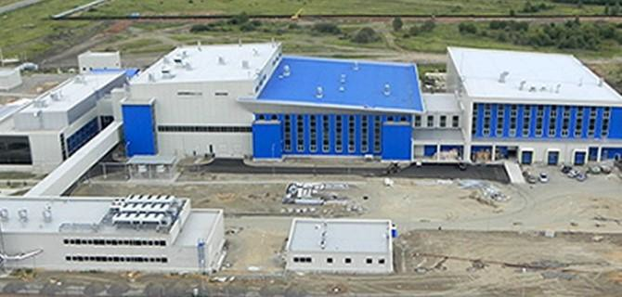
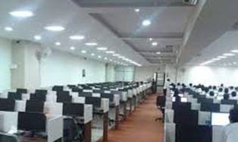
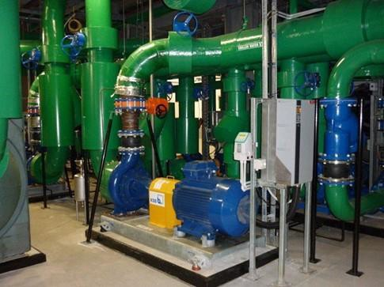
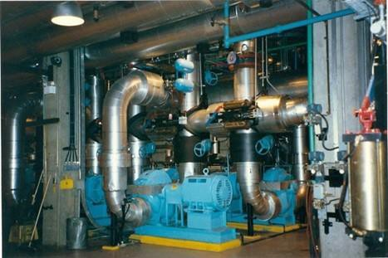
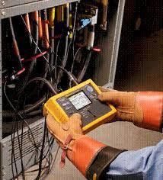

ENCON
Energy Management Services Pvt. Ltd.

Slide 2
Mission
Sustainability through
Energy Efficiency

Slide 3
Govt Registrations
Empaneled with BEE as Grade-2 ESCO
Class-A ESCO Empaneled with MEDA
Empaneled with GEDA
PF & ESIC Compliant
MSME Registration with Govt of Maharashtra
SME Grading by CRISIL
NSIC Registration
ISO Certification

Slide 4
Credentials of Founder-Director
BE(Elect)-1972; University of Roorkee(IIT).
BEE Accredited Energy Auditor (AEA-0246)
BEE Energy Auditor(EA-1050)-2004
Qualified CMVP professional.
ISO-50001 –EnMS Lead Auditor
Vast experience with credentials of all major industries and Groups

Slide 5
Key Personnel of the Organization
Cdr S Kumar(Retd), Director ;BE(Elect), IITR, AEA-0246; EA-
1050; CMVP; IS0-50001
Mr Amit Surendra Kumar, Director; B.COM, MBA
Mr VS Saraf, BE(Mech); EA-3067; Lead Auditor-QMS, EMS, OSHA & Energy & Asset Management.
Mr. P. Daspute, EA
Mr. Nilesh Zaware, M.Tech(Energy )
Mr. Atul Chille, BE(Elect).
2 M.Tech Interns
4 supporting technical staff for Energy Audits & LED lighting Projects
5

Slide 6
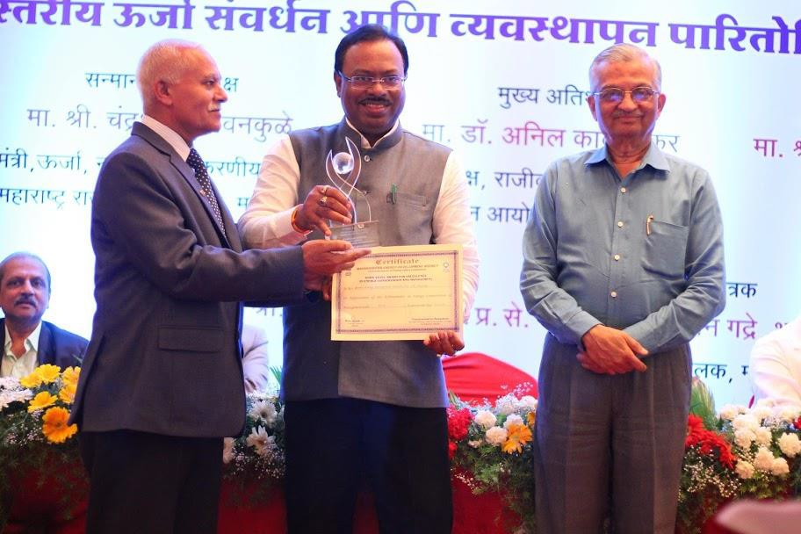
Participated and own MEDA State Level E.C. Award (8th, 9th
,10 & 11th in ESCO & E.A. Category)
E.C. MEDA Award

Slide 7
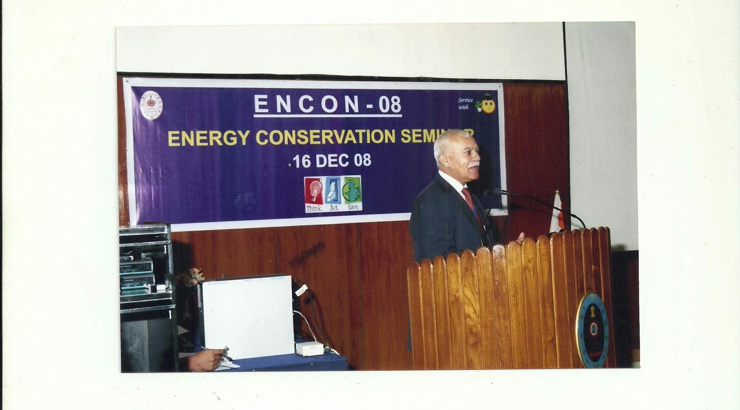
Training in Energy Conservation is our CSR

Slide 8
Business Activities
Energy Audits(Ashre-Level-1,2&3).
Water Pumping System Audits & Water Balancing/Conservation.
Electrical Safety Audit.
Plant System Audit for Productivity & Energy Efficiency.
Energy Conservation related Services Lighting Projects: including design, supply& installation as well as on ESCO basis.
ESCO projects for Utilities and Solar PV.
Training to spread awareness about Need for Energy Conservation .
Consultancy at Project Stage to ensure Energy Efficiency in
Operations of Utilities & Buildings.

Slide 9
Equipment & System Covered in Energy Audits
Power Distribution System.
Compressed Air System
Chillers& Chilled Water System.
Cooling Towers and Cooling Water System.
Study of Pumps and Pumping System including verification of Pipe Sizes.
Boilers & Steam Distribution System.
Lighting
Any other equipment with major power consumption.

Slide 10
Sequence of Activities for Energy Audit
Getting Pre-audit data of equipment and its study as part of
Preliminary Data
collection
preparation for plant visit.
Walk-through in plant to understand plant systems, operating practices and making ‘macro-level’ assessment of Energy Saving Potential. This is followed by Quotation and finalization of Order for Energy Audit.
AHSRAE
Level I
ASHRAE
Level II & III
Carrying-out detailed energy audit-measurements, analysis of data, finding opportunities for Energy Saving, making action plan for Energy Conservation with calculation of savings and investment, ROI.
Presentation/discussions are held on findings and recommendations. We facilitate finalization of Action Plan for client to implement Energy Saving Projects. Also, we provide support to Clients as and when required for equipment selection, system design, etc
Presentation
& Post-Audit
Support

Slide 11
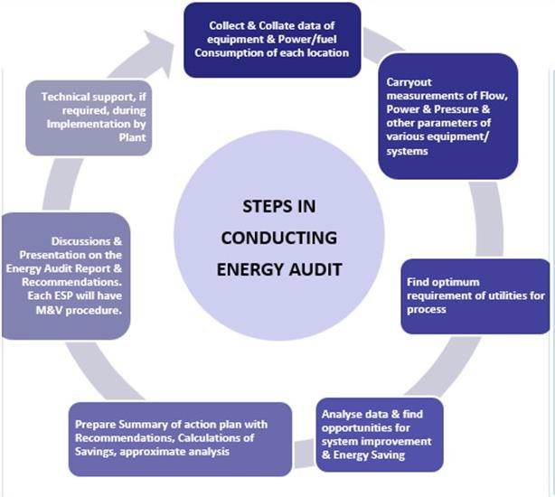
Methodology for conducting Energy Audit

Slide 12
Focus
We adopt holistic approach of ‘system improvement and
energy efficiency ‘ for maximizing savings in bills.
Focus is on techno-commercial projects. In most cases ‘over-all ROI is below 12 months. A few individual projects needing Technology up-gradation / replacement may have higher ROI of 24-30 months..
Study should consider least requirement of plant shut- down to avoid/ minimize negative effect of Energy-saving projects on production.
When recommending procurement of New Equipment,
concept of ‘Life-cycle costing’ is followed.
12

Slide 13
Sectors of Industry Covered
IT Sector
Banks
Railways
Airports
Water Pumping Stations
Milk Dairies
Ship Repair Yards
Merchant Ships
Municipal Corporations
Training in Energy
Conservation
Chemical & Pharmaceutical
Steel Plants
Pulp & Paper
Textiles
Power Plants
Distilleries
Polyester Film Plants
Hotels
Automobile

Slide 14
Maximum Energy Audits undertaken in API/Pharma Plants
Lupin Limited-Multiple locations of the Group
Ipca Laboratories-Multiple Locations-Group
Sun Pharma-Multiple Locations-Group
Teva Pharma-Multiple Locations
Cadilla Heathcare-3 plants
Emcure Pharma-2 plants
Matrix(Mylan)
Wockhart
Watson

Slide 15
Electrical Safety and Energy Audits in Govt. Organizations
Railways
Indian Navy
Banks-RBI, SBI, BoB
Hospitals
Air Ports
Govt Offices

Slide 16
Instruments
Power Analyzers(6 nos)
Ultra-sonic Flow Meters(3 nos)
Thermal Imaging Cameras(2 nos)
Flue-gas Analyzer
Pitot Tube for Boiler Stack Study
Ultra-sonic Air-leak Detector
Digital Manometer with Pitot Tube
Temp Logging System
LED Stroboscope
Lux Meters(4)
IR Meters(4)
Earth Tester

Slide 17




















































CLIENTS
Indian Navy

Slide 18
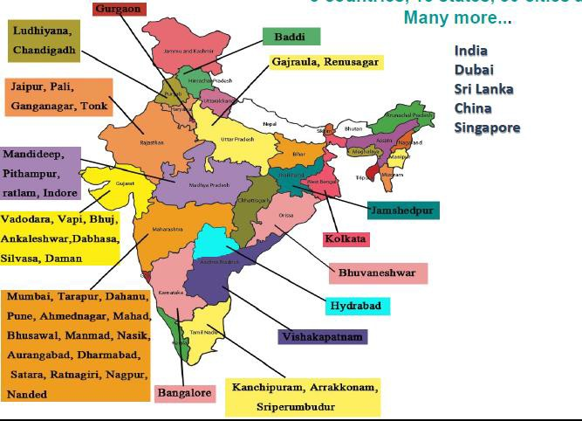
Our Presence

Slide 19


Together, we can make a difference
Energy is Life. Conserve It!
Save Energy for the Benefit of Self, Nation & Environment.
ENCON ENERGY MANAGEMENT SERVICES PVT. LTD.
Regd. Office: L-51, J.V.V., Hiranandani Garden, Powai, Mumbai - 400 076.
Pune Office: 402, 4th Floor, Zen Business Centre, Wakad, Chinchwad Pune- 411 057 E-mail: cdrskumar@yahoo.co.in, dir@enconenergy.in Website: www.enconenergy.in
CIN: U93000MH2007PTC173935; GST: 27AABCE8793Q1ZO

